Slide 1

Statistical Project House Pricing Predictions Pouya Gohari SID: 810102113

Slide 2
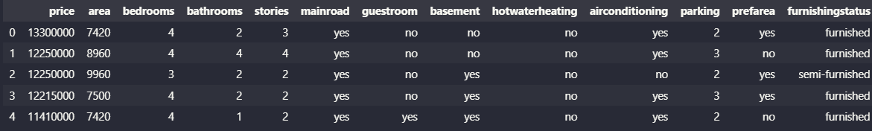
Describe Dataset

Slide 3
Contents to be discussed
Visualization
Parametric Inference and Estimation
Hypothesis Inferences
Regression Analysis

Slide 4
Visualization
Histograms
Box Plots
Pair plots and correlation matrix
Q-Q plots
Heatmap plot & Mosaic plots
Bar plots

Slide 5
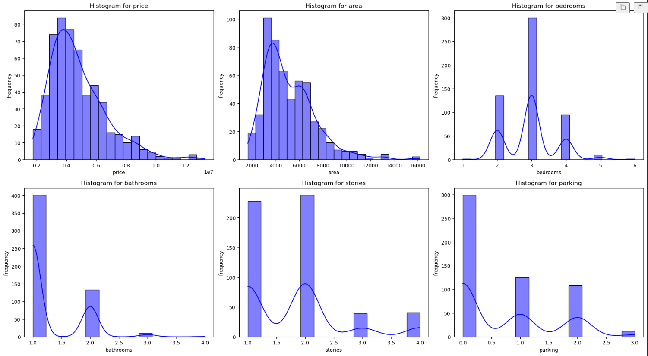
Histograms

Slide 6
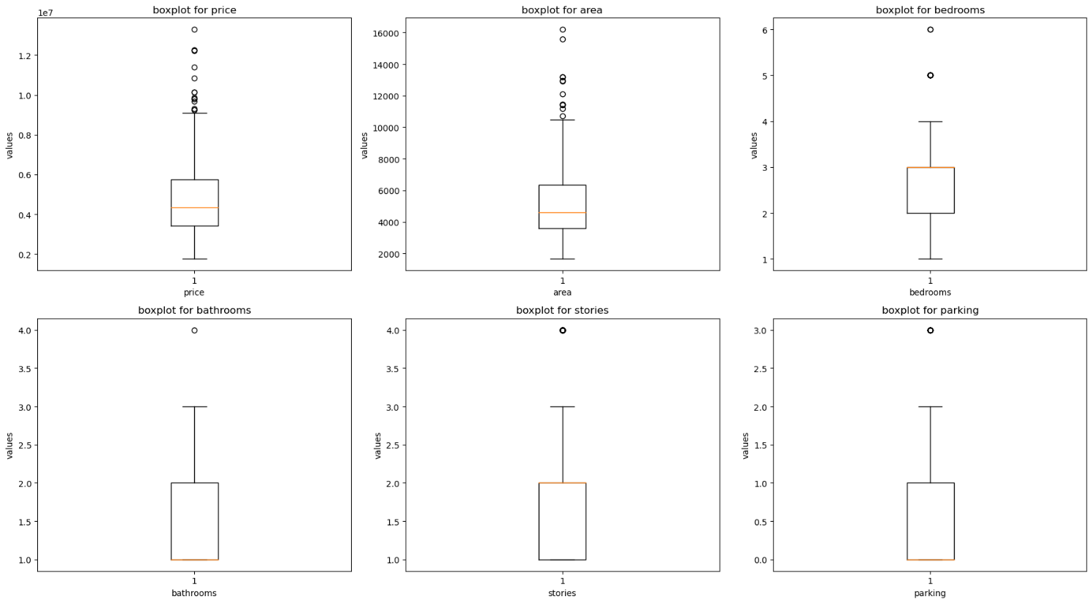
Box Plots

Slide 7
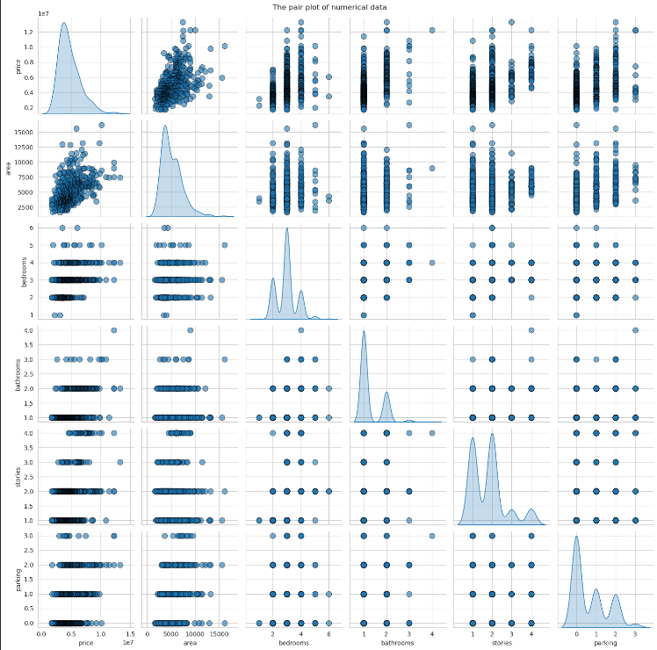
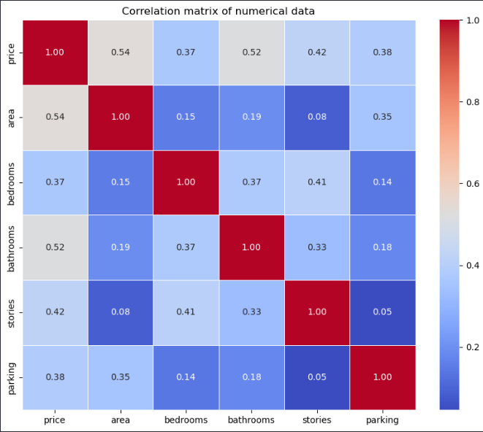
Pair Plot and Correlation Matrix

Slide 8
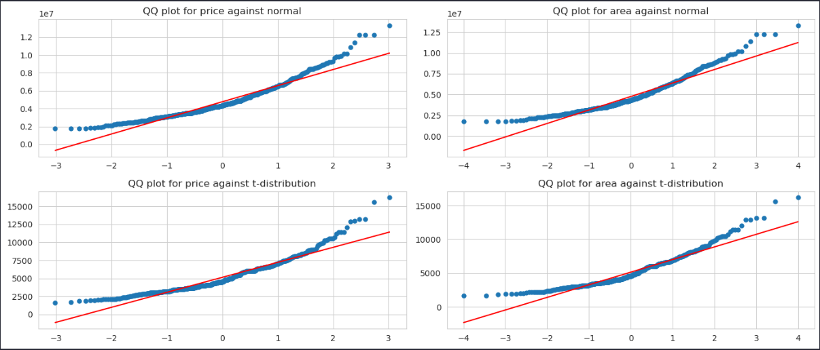
Q-Q plots
None of the are Normal
They are not following t-distribution either

Slide 9
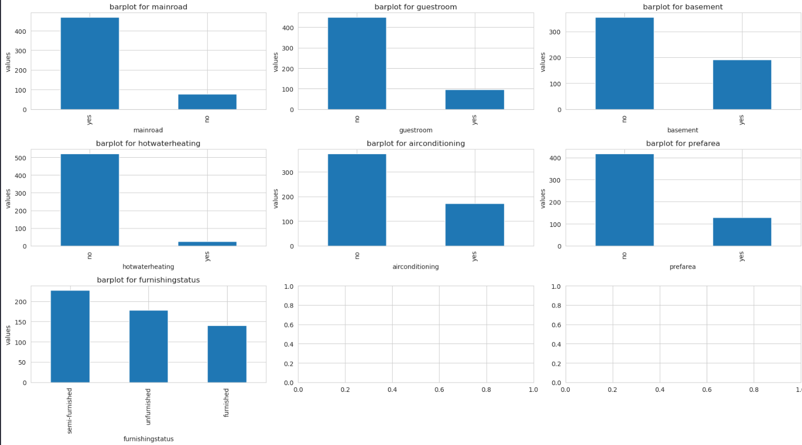
Bar Plots

Slide 10
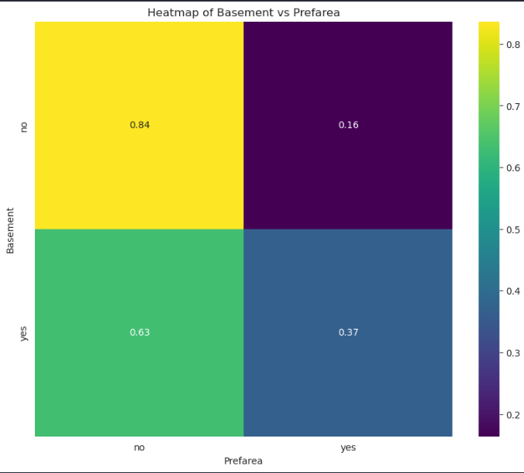
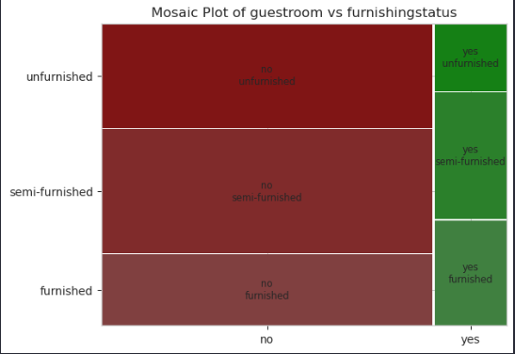
Heatmap & Mosaic Plots

Slide 11
Parametric Inferences & Estimations
Shapiro test for normality
Shapiro test on Transformed Data
T-test
Bootstrap
Conduct Percentile Interval for CI
Fit MLE params to Normal & Gamma Distributions
Conduct CI(Exact Method & Fisher information)

Slide 12
Shapiro Test
An non-parametric Test
Null hypothesis is price & area are normal
Alternative hypothesis Data will not follow Normal Distribution
Shapiro test for | Price | Area
P-value | 3.15e-16 | 2.5e-17

Slide 13
Transform data with Box Cox
Transform data with Box Cox function
Repeat Shapiro test
Shapiro on | Price | Area
P-value | 0.50 | 0.02

Slide 14
T-test
A parametric test
Null hypothesis is the mean of both sample are equal.
An naïve idea is getting two samples from same population but from CLT we know they are equal to each other.
A brilliant idea is to see if the mean of price for houses based on a categorical feature are equal or not!
Mean of prices’ of houses with basement are equal to mean of houses without basement?
Statistic | P-value
4.43 | 9.11e-6

Slide 15
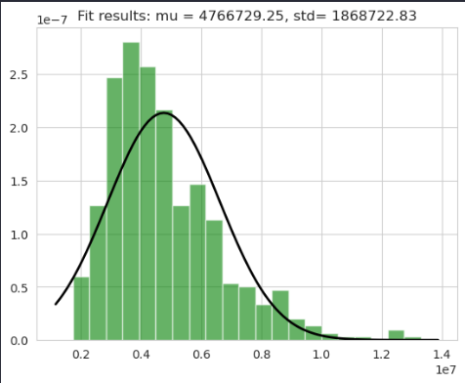
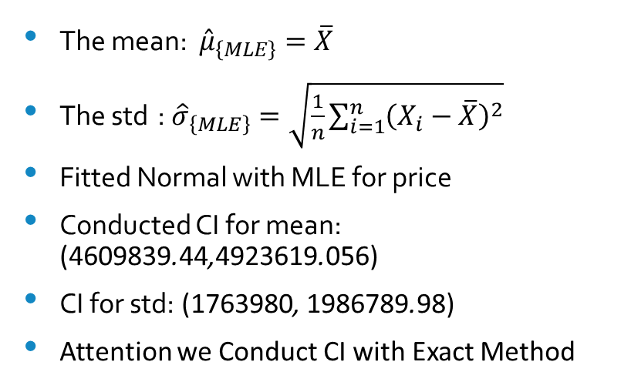
MLE for Normal
The mean: ${\hat{μ}}_{\left\{MLE\right\}}=\overline{X}$
The std : ${\hat{σ}}_{\left\{MLE\right\}}=\sqrt{\frac{1}{n}\sum_{i=1}^{n}{{\left(X_{i}−\overline{X}\right)}^{2}}}$
Fitted Normal with MLE for price
Conducted CI for mean: (4609839.44,4923619.056)
CI for std: (1763980, 1986789.98)
Attention we Conduct CI with Exact Method

Slide 16
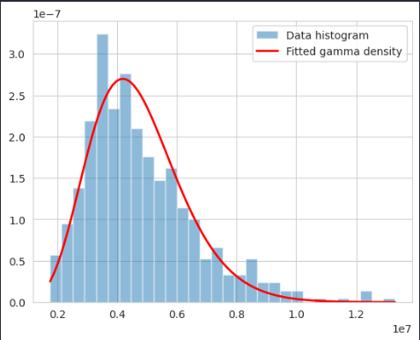
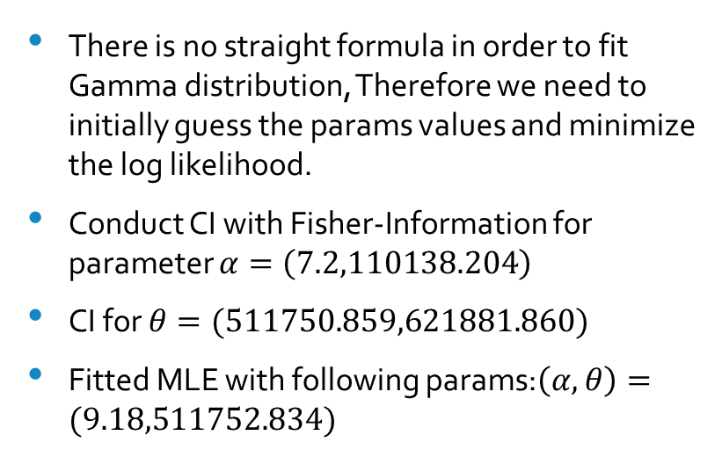
MLE for Gamma Distribution
There is no straight formula in order to fit Gamma distribution, Therefore we need to initially guess the params values and minimize the log likelihood.
Conduct CI with Fisher-Information for parameter $α=\left(\text{7.2},\text{110138.204}\right)$
CI for $θ=(\text{511750.859},\text{621881.860})$
Fitted MLE with following params:$\left(α,θ\right)=(\text{9.1}8,\text{511752.83}4)$

Slide 17
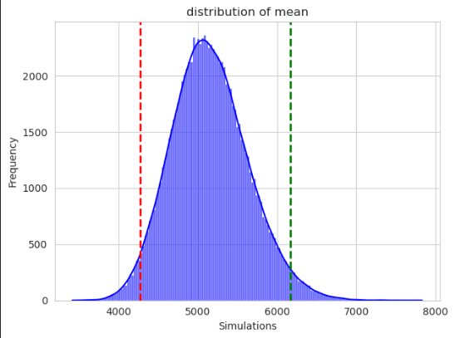
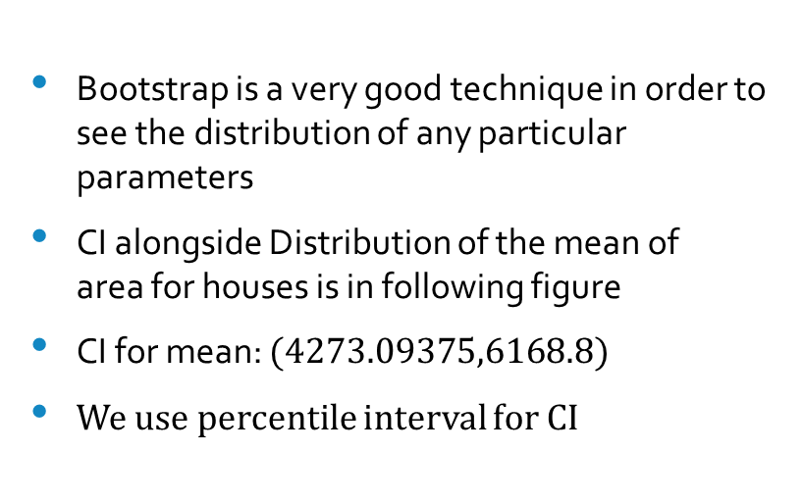
Bootstrap alongside CI
Bootstrap is a very good technique in order to see the distribution of any particular parameters
CI alongside Distribution of the mean of area for houses is in following figure
CI for mean: $(\text{4273.09375},\text{6168.8})$
We use percentile interval for CI

Slide 18
Hypothesis Testing
Spearman & Pearson Correlation Tests
One-Way ANOVA & Kruskal-Wallis Tests
Tukey’s & Dunn’s Method
Sign & Wilcoxon Test
Contingency Table for Independency Test

Slide 19
Spearman & Pearson Tests between “price”& “area”
Pearson Test
Spearman Test
Parametric Test(Normality Assumptions)
R-statistic is 14.8, p-value is 7.32e-42
They are correlated
But price and area are not normal can we really trust this test ?
Non-parametric Test(No Assumptions)
Correlation Coefficients is 0.6
P-value is 3.12e-55

Slide 20
One-Way ANOVA & Kruskal-Wallis Between “price” & “furnishingstatus”
One-Way ANOVA
Kruskal-Wallis
Is there any difference between the mean of prices where they are furnished, un-furnished and semi-furnished?
The F-statistic is 545625.13
The p-value is zero
We have examined ANOVA for transformed data but not the real price data!
An alternative non-parametric test for One-Way ANOVA.
Are the means of real prices data based on furnishing status equal to one another?
The Statistic is 69.58
The p-value is 7.76e-16

Slide 21
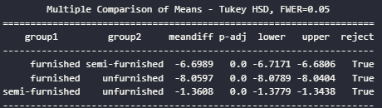

Tukey’s & Dunn’s Methods
Tukey
Dunn

Slide 22

Two-Way ANOVA between transformed “price”, “ariconditioning” and “mainroad”
A two-way ANOVA is typically used when we want to understand if there is an interaction effect between the two categorical variables on the dependent variable.

Slide 23
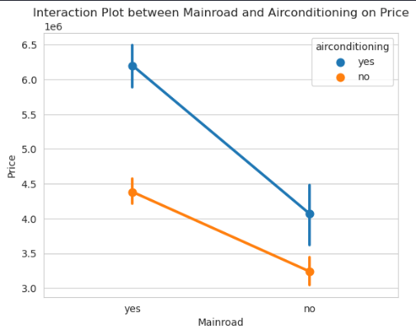
Illustration of no interaction

Slide 24

Contingency Table between “bedrooms” & “price”
Assign three label to price
Create contingency table
Degree of freedom of table is 10
Chi-Square statistic is 54.06
P-value is 7.16e-10

Slide 25
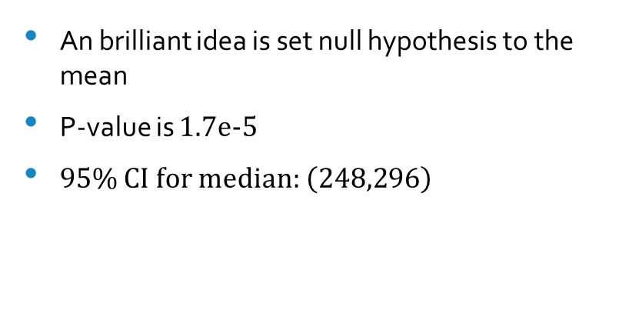
Sign & Wilcoxon Tests
Sign for median of price
Wilcoxon for area
An brilliant idea is set null hypothesis to the mean
P-value is 1.7e-5
95% CI for median: $\left(248,296\right)$
Set null hypothesis to the real median
P-value is approximately zero
Why Wilcoxon test reject the real median ?

Slide 26
Regression Analysis
Fit Regression line between “price” and “area”
Plot the residual
Perform KS test for residuals
Bootstrap to obtain distribution of slope
Fit regression line between all data for price

Slide 27
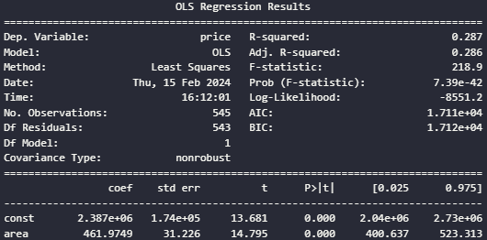
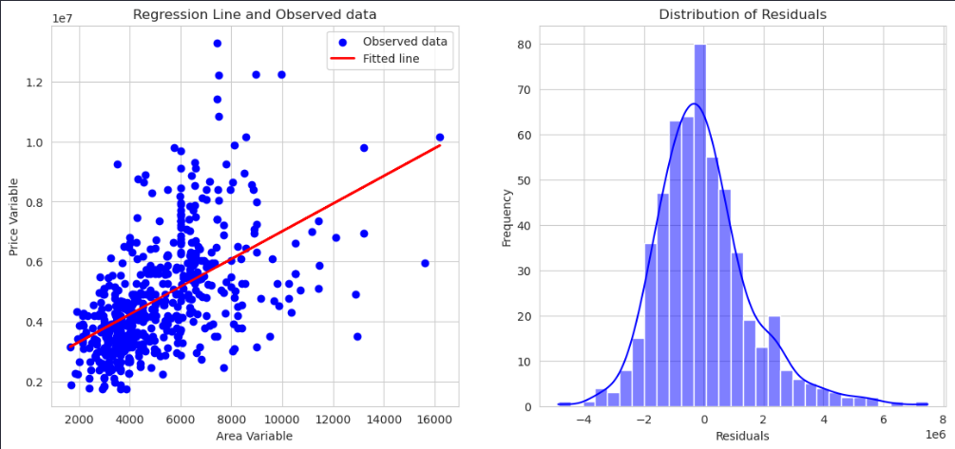
Regression Line between “price” & “area”

Slide 28
Is residuals comes from normal?
We can perform KS test to answer the question
Null hypothesis is, the samples comes from P distribution.
Statistic | P-value
0.084 | 0.0008

Slide 29
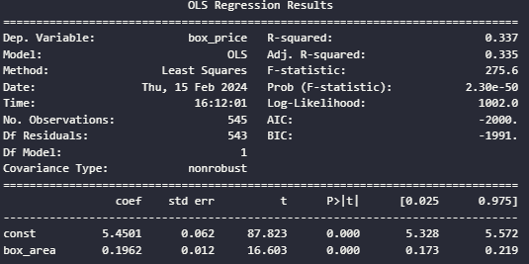
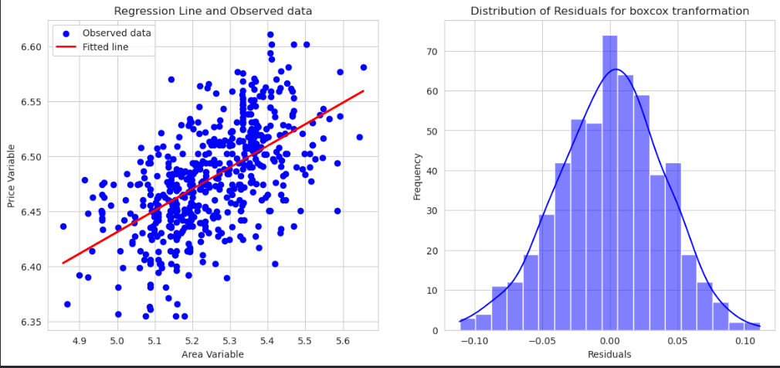
Transformed data and recheck

Slide 30
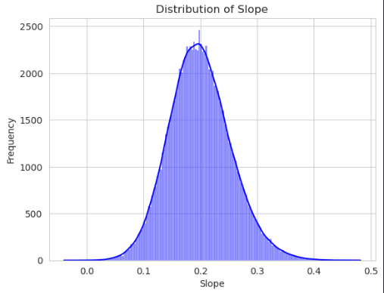
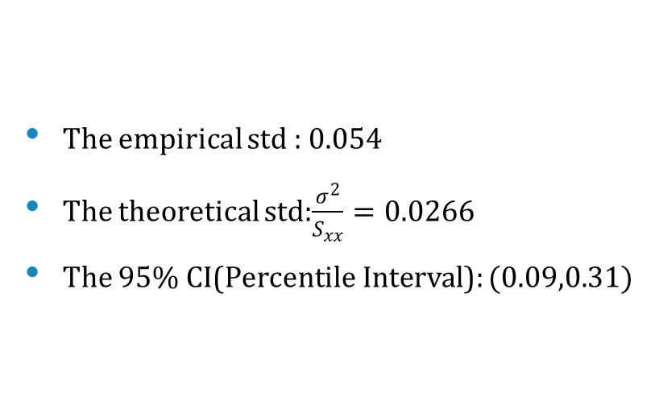
Distribution of Slope with Bootstrap
The empirical std : 0.054
The theoretical std:$\frac{σ^{2}}{S_{xx}}=\text{0.0266}$
The 95% CI(Percentile Interval): $(\text{0.09},\text{0.31})$

Slide 31
Encode The Categorical features
Encode “furnishing status” with mapping
1. “furnished” : 2
2. “semi-furnished” : 1
3. “unfurnished” : 0
Assign “yes” to 1 and “no” to 0

Slide 32
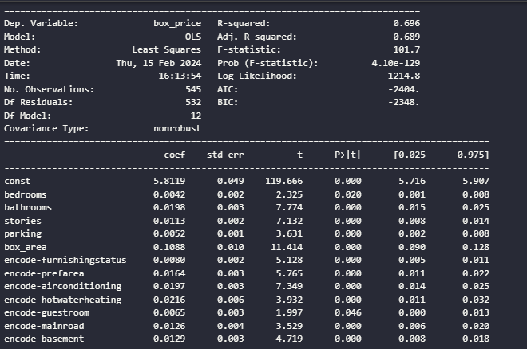
Fit Regression line with all numbers

